Slide 1
Photo Album
By sarayu

Slide 2
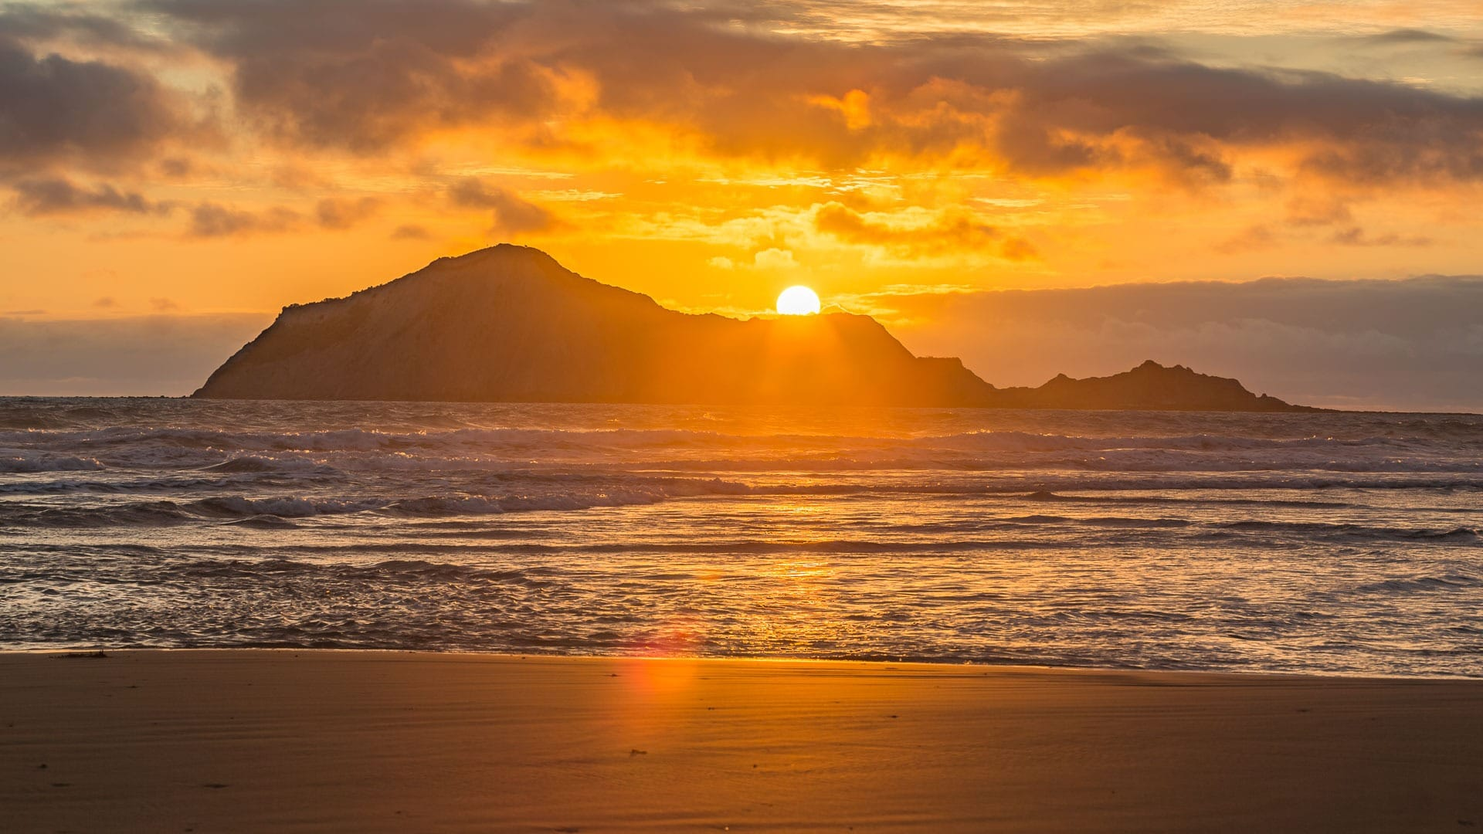

Slide 3


Slide 4


Slide 5
